Slide 1
Les couleurs
Digitální učební materiál byl vytvořen v rámci projektu
Inovace a zkvalitnění výuky na Slovanském gymnáziu
CZ.1.07/1.5.00/34.1088

Slide 3
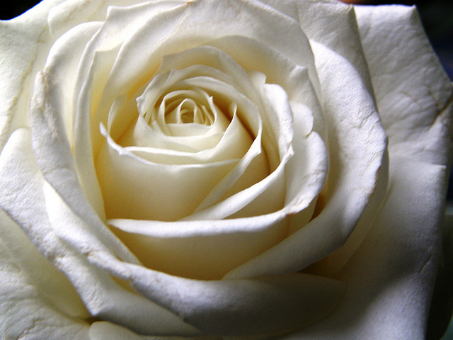

Slide 4
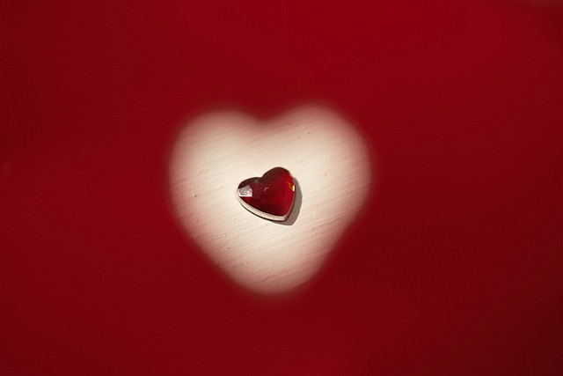

Slide 5
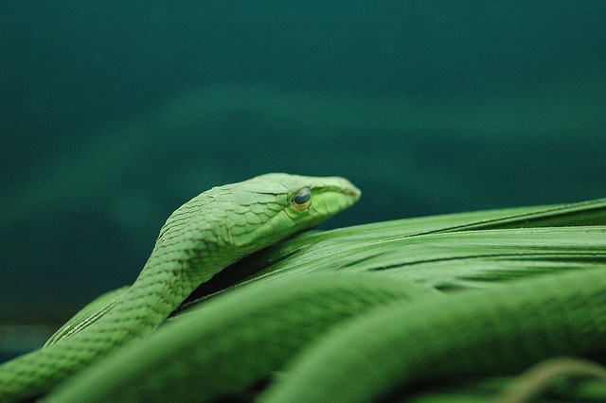

Slide 6
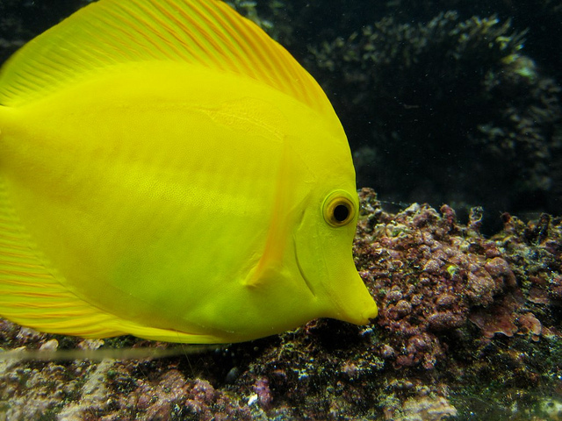

Slide 7
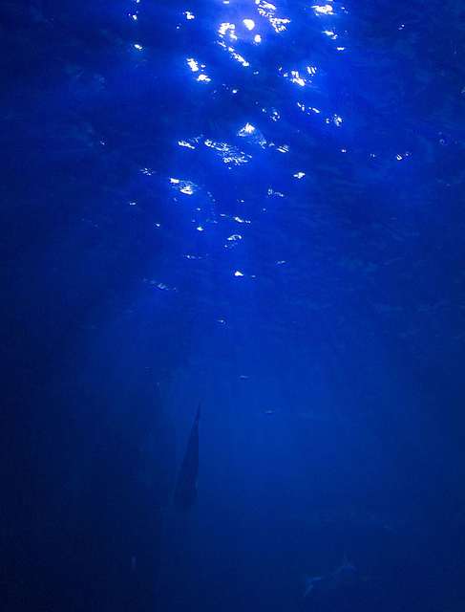

Slide 8
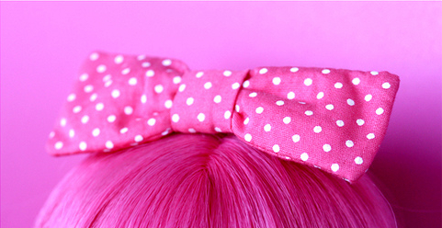

Slide 9
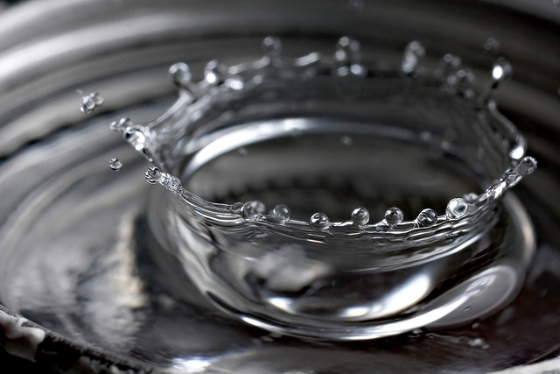

Slide 10
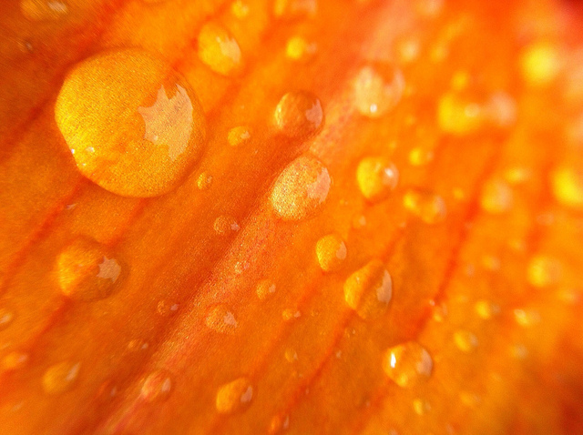

Slide 11
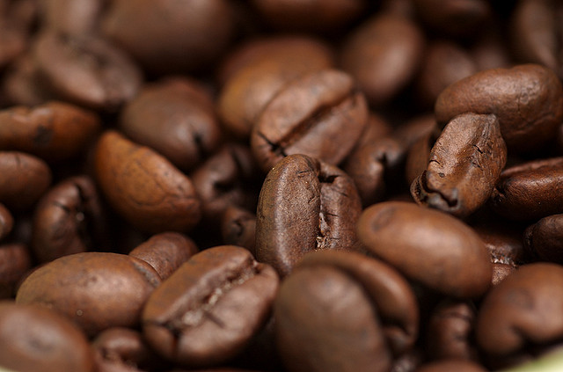

Slide 12
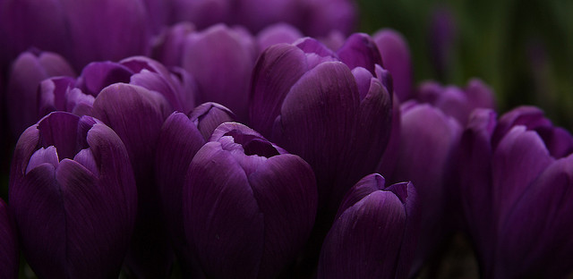

Slide 13
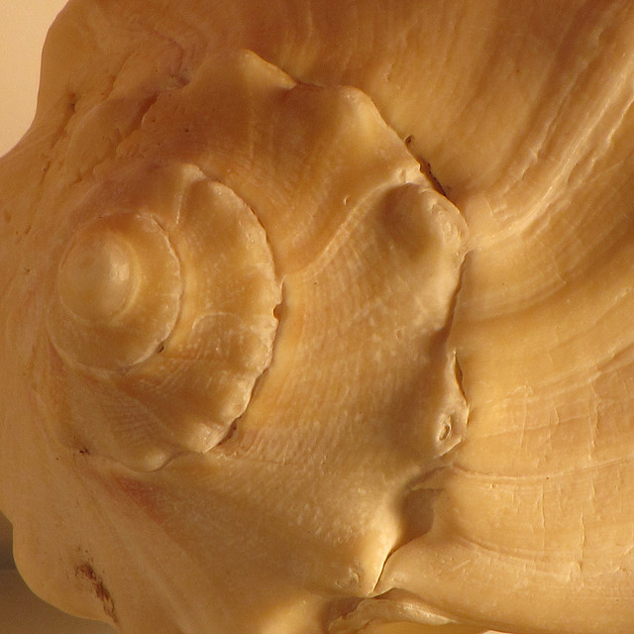

Slide 14
marron
jaune
gris
rouge
violet
blanc
vert
noir
orange
rose
bleu
beige

Slide 15
Le féminin
rouge
jaune
rose
beige
orange
blanc → blanche
gris → grise
vert → verte
bleu → bleue
noir → noire
violet → violette
marron
lilas

Slide 16
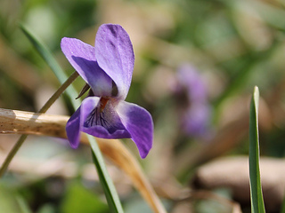
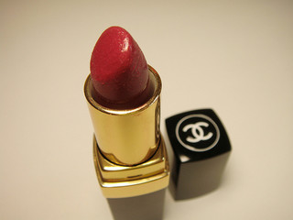
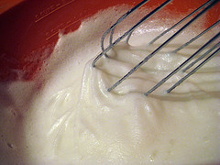
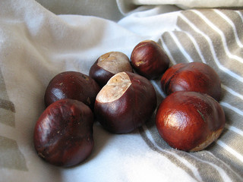
Certaines couleurs nomment des objets. Devinez.
rouge
blanc
marron
violet

Slide 17
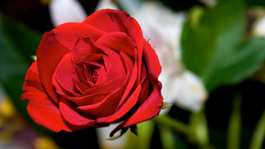
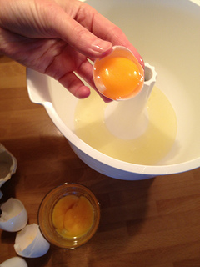
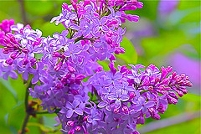
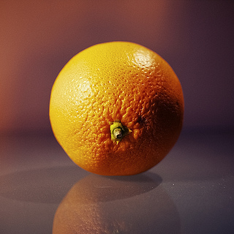
jaune
lilas
orange
rose

Slide 18
Odkazy:
NEAL PHOTOSTREAM. www.flickr.com [online]. [cit. 12.10.2013]. Dostupný na WWW: www.flickr.com/photos 31878512@N06/3528701110/">Neal. via photopin cc
LILLI2DE'S PHOTOSTREAM. www.flickr.com [online]. [cit. 12.10.2013]. Dostupný na WWW: www.flickr.com/photos/seven_of9/4035138169/">lilli2de via photopin cc
AMASSARD'S PHOTOSTREAM. www.flicker.com [online]. [cit. 12.10.2013]. Dostupný na WWW: www.flickr.com/photos/amassard/5761637304/">amassard via photopin cc
SPO0NMAN. www.flickr.com [online]. [cit. 12.10.2013]. Dostupný na WWW: http://www.flickr.com/photos/pankaj/233669459/">spo0nman via photopin cc
JANISSON'S PHOTOSTREAM. www.flickr.com [online]. [cit. 12.10.2013]. Dostupný na WWW: www.flickr.com/photos/janisson/5248387377/">Jérémie Janisson via photopin cc
JONES'S PHOTOSTREAM. www.flickr.com [online]. [cit. 12.10.2013]. Dostupný na WWW: www.flickr.com/photos/karinhodginjones/2846147451/">karin jones via photopin cc
AMAGILL'S PHOTOSTREAM. www.flickr.com [online]. [cit. 12.10.2013]. Dostupný na WWW: www.flickr.com/photos/amagill/4426058749/">AMagill via photopin cc
BACKPACKPHOTOGRAPHY'S PHOTO STREAM. www.flickr.com [online]. [cit. 12.10.2013]. Dostupný na WWW: www.flickr.com/photos/backpackphotography/2367413093/">backpackphotography via photopin cc
LILLI2DE'S PHOTOSTREAM. www.flickr.com [online]. [cit. 12.10.2013]. Dostupný na WWW: www.flickr.com/photos/80901381@N04/7530054972/">A Guy Taking Pictures via photopin cc
BLUERIDGEKITTIES' PHOTOSTREAM. www.flickr.com [online]. [cit. 12.10.2013]. Dostupný na WWW: www.flickr.com/photos/blueridgekitties/4123267661/">BlueRidgeKitties via photopin cc
DECLAN TM'S PHOTOSTREAM. www.flickr.com [online]. [cit. 12.10.2013]. Dostupný na WWW: www.flickr.com/photos/declanjewell/3041114870/">DeclanTM via photopin cc
RENATA'S PHOTOSTREAM. www.flickr.com [online]. [cit. 12.10.2013]. Dostupný na WWW: www.flickr.com/photos/renatamotta/2471812753/">r e n a t a via photopin cc

Slide 19
XJS-KHAOS' PHOTOSTREAM. www.flickr.com [online]. [cit. 12.10.2013]. Dostupný na WWW: www.flickr.com/photos/xjs-khaos/4500193342/">Xjs-Khaos via photopin cc
AVHELL'S PHOTOSTREAM. www.flickr.com [online]. [cit. 12.10.2013]. Dostupný na WWW: www.flickr.com/photos/patdavid/7024673517/">avhell via photopin cc
GMAYSTER01ON&OFF...'S PHOTOSTREAM. www.flickr.com [online]. [cit. 12.10.2013]. Dostupný na WWW: www.flickr.com/photos/10422334@N08/4525994956/">gmayster01 on & off ... via photopin cc
KARIN JONES' PHOTOSTREAM. www.flickr.com [online]. [cit. 12.10.2013]. Dostupný na WWW: www.flickr.com/photos/karinhodginjones/2846147451/">karin jones via photopin cc
SOAPBEARD'S PHOTOSTREAM. www.flickr.com [online]. [cit. 12.10.2013]. Dostupný na WWW: www.flickr.com/photos/soapbeard/2929156956/">soapbeard via photopin cc
ANNIE MOLE'S PHOTOSTREAM. www.flickr.com [online]. [cit. 12.10.2013]. Dostupný na WWW: www.flickr.com/photos/anniemole/3191447382/">Annie Mole via photopin cc
CWASTESON'S PHOTOSTREAM. www.flickr.com [online]. [cit. 12.10.2013]. Dostupný na WWW: www.flickr.com/photos/wastes/8401648376/">cwasteson via photopin cc
BENOIT SIMPLE ESCARGOT PHOTOSTREAM. www.flickr.com [online]. [cit. 12.10.2013]. Dostupný na WWW: www.flickr.com/photos/14382098@N03/7014775915/">Benoît, simple escargot via photopin cc
Audio: archiv autora

